Slide 1


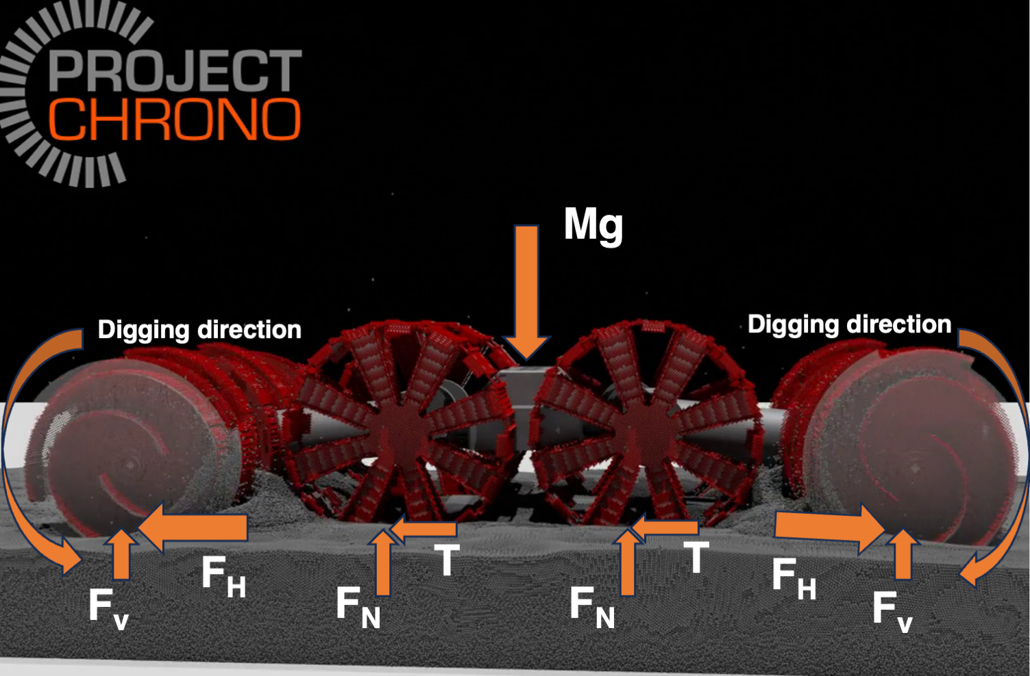
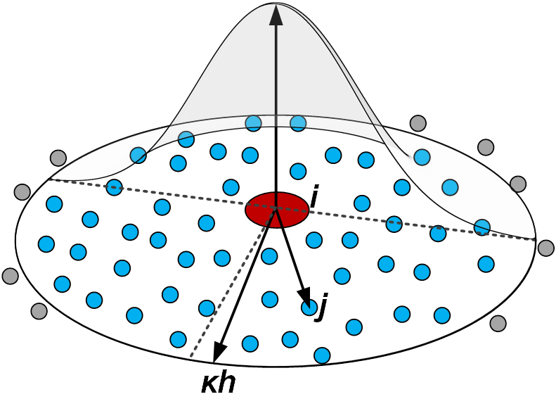
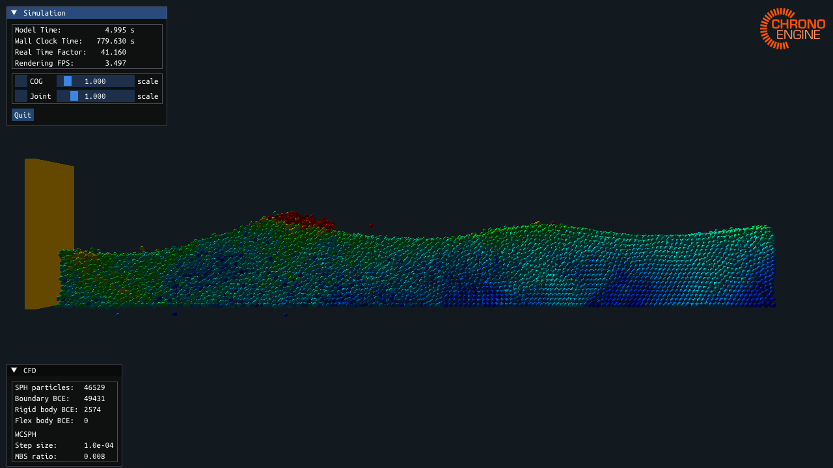
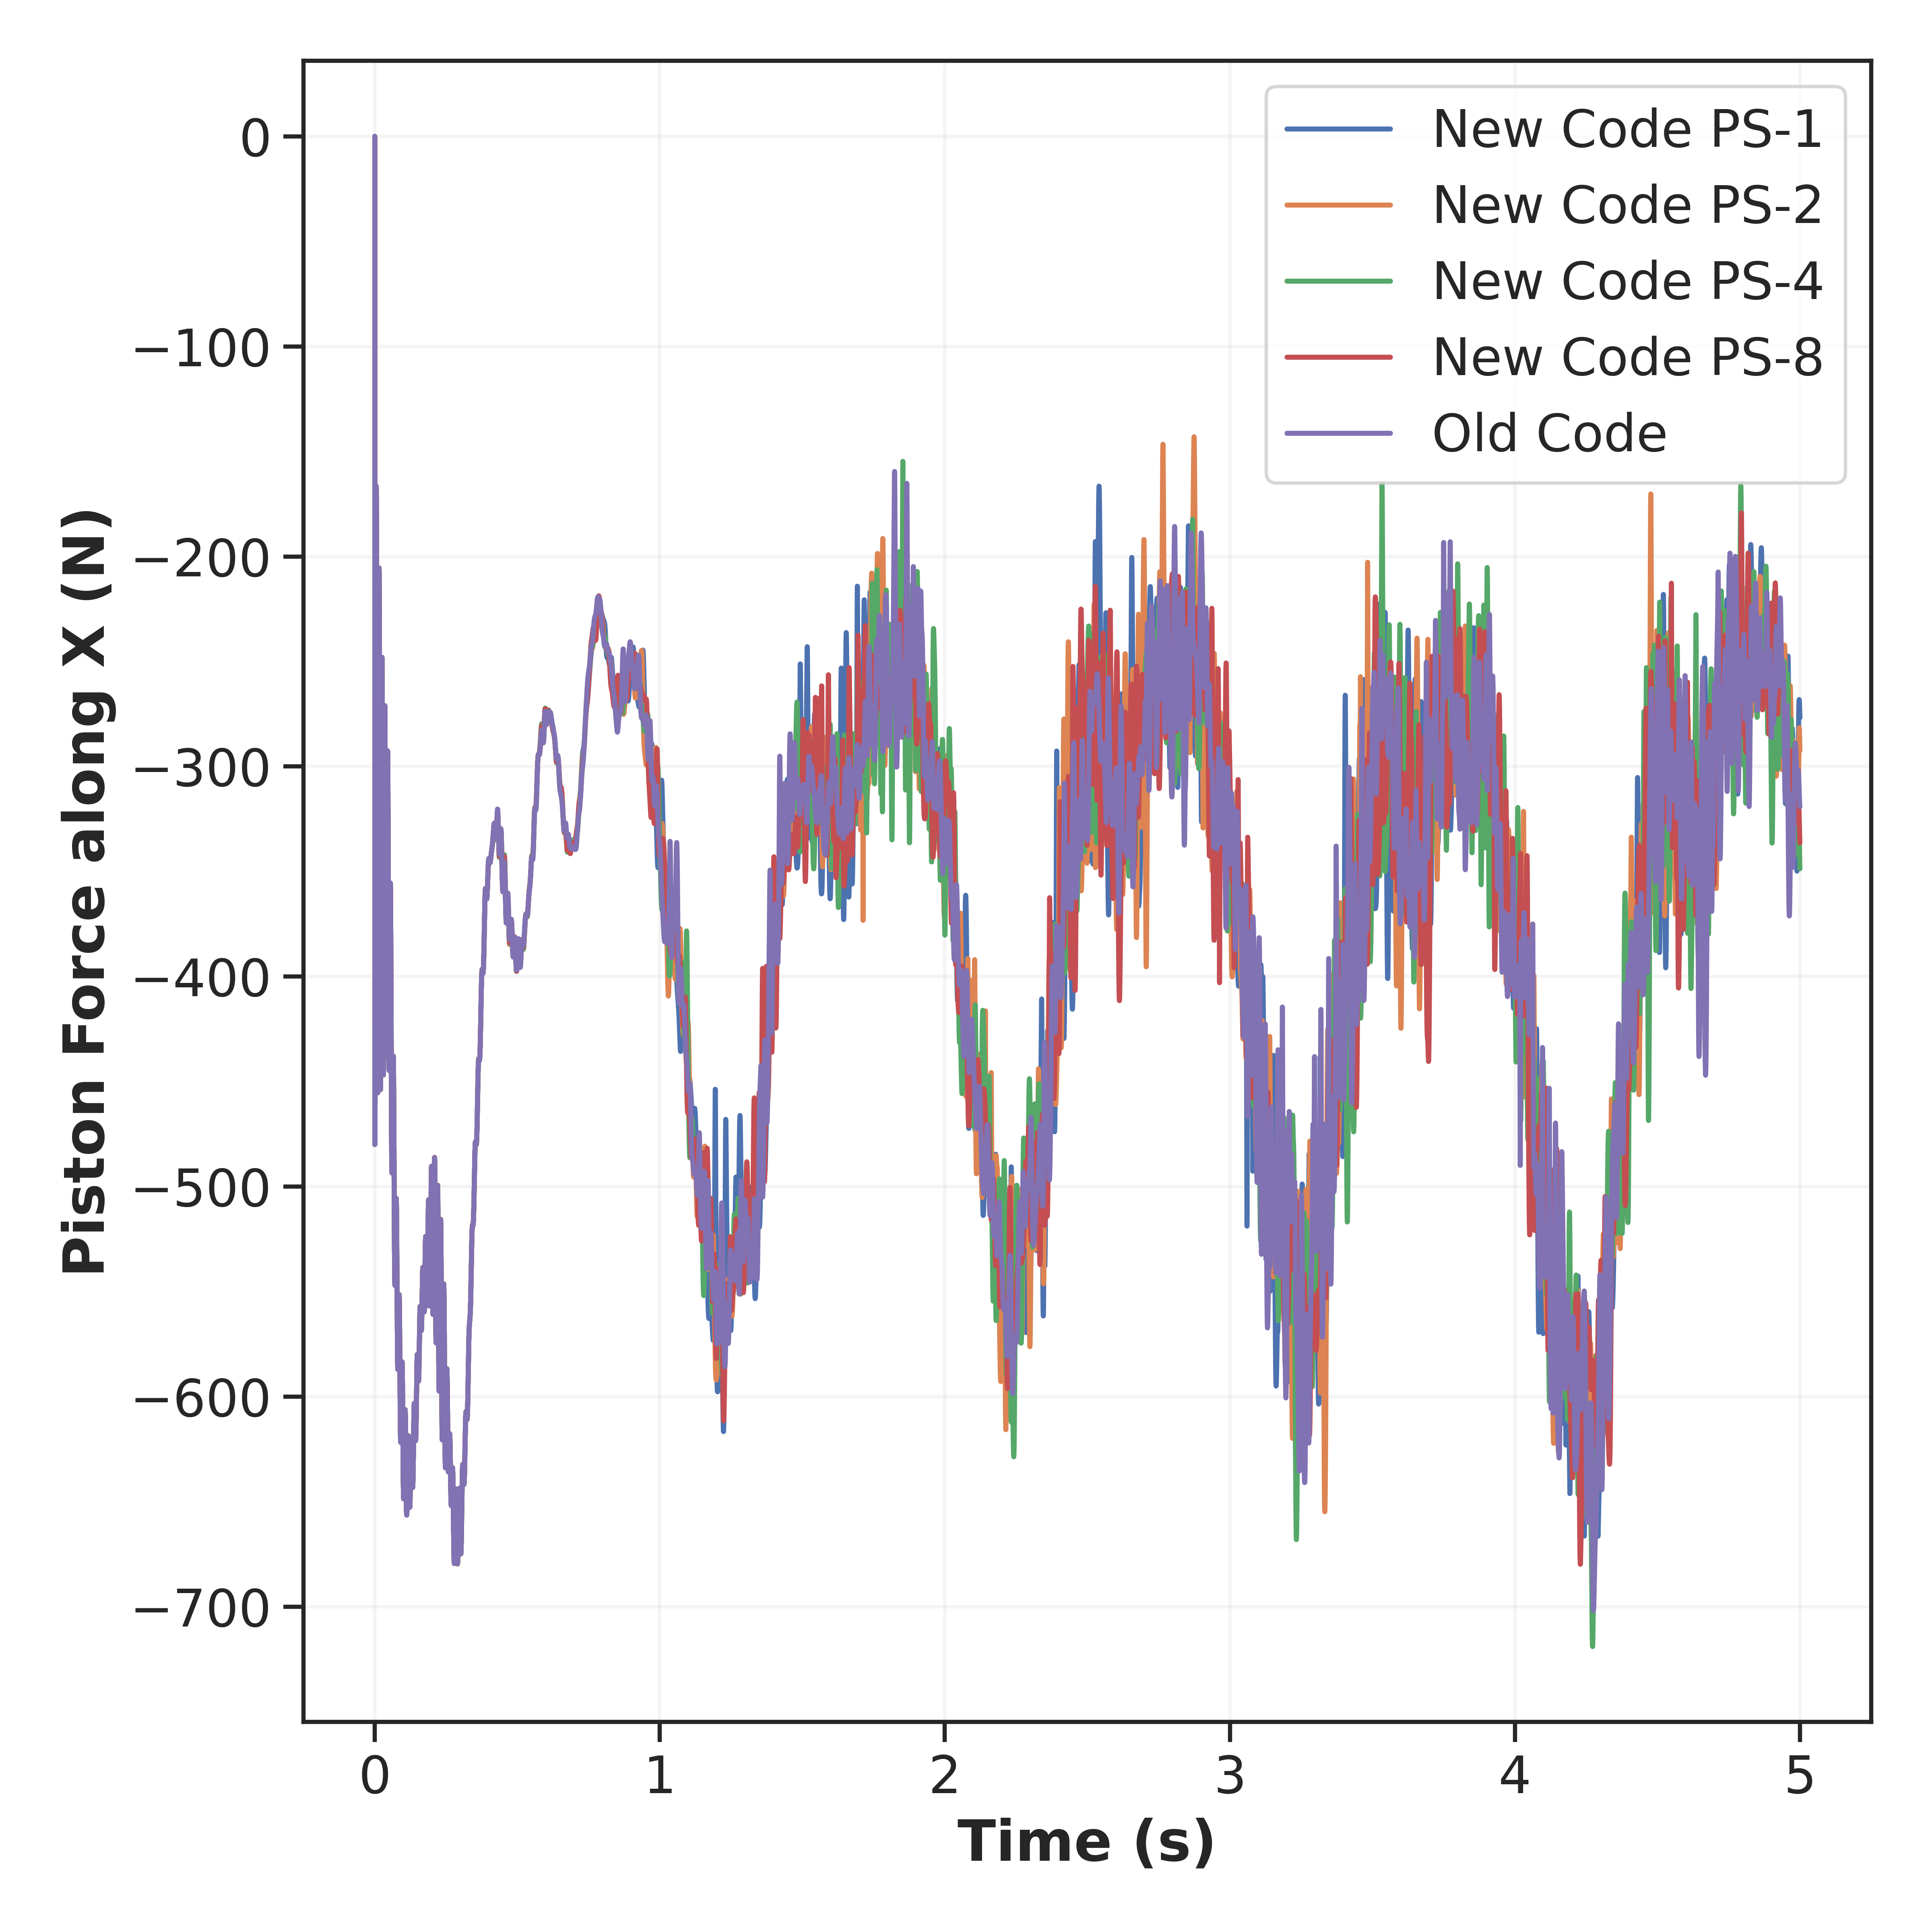
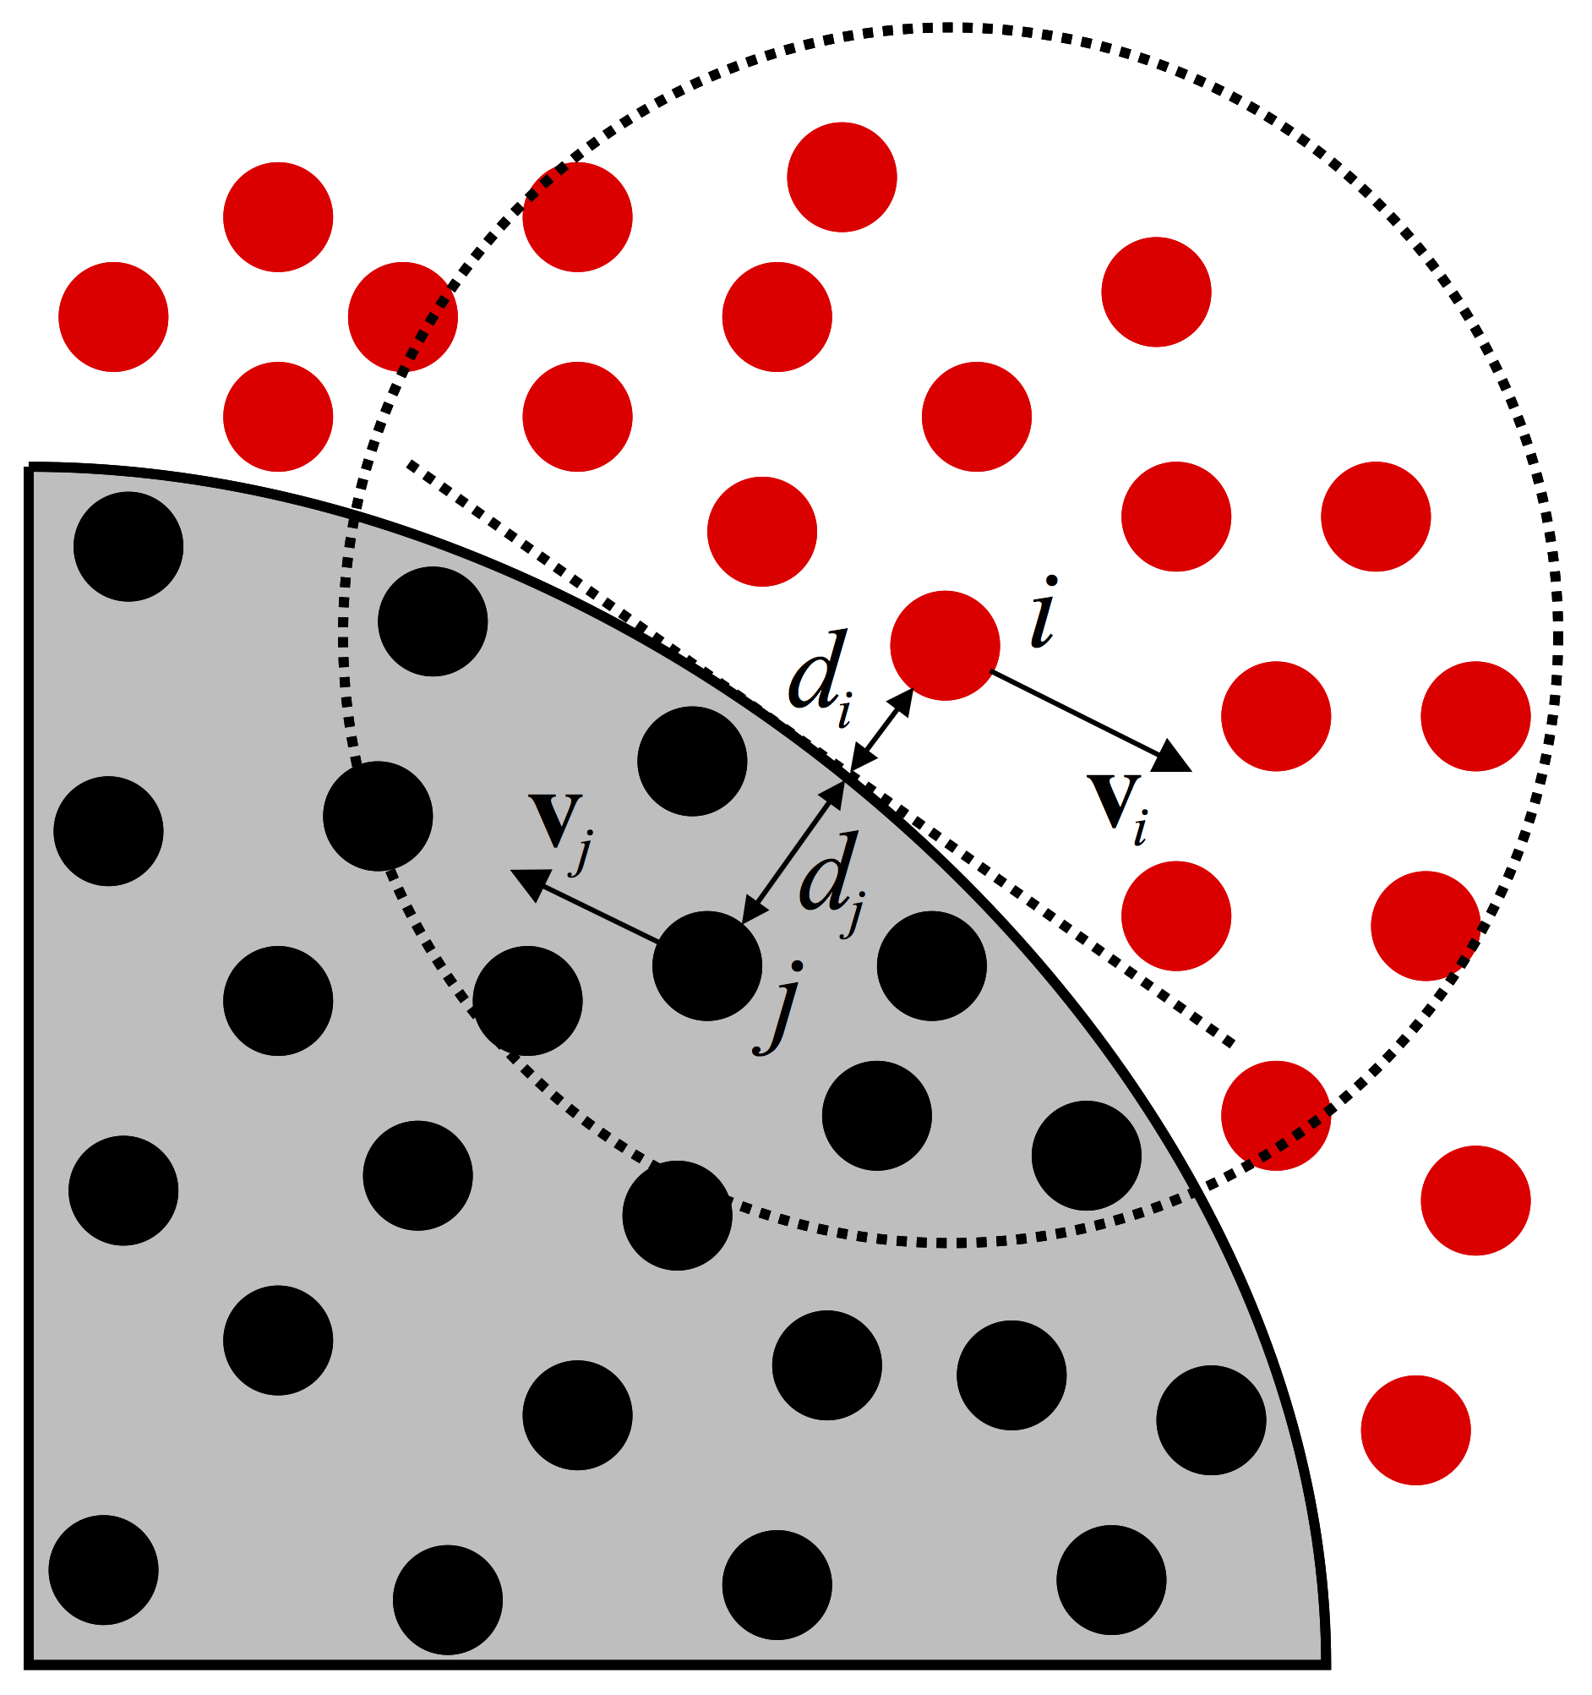
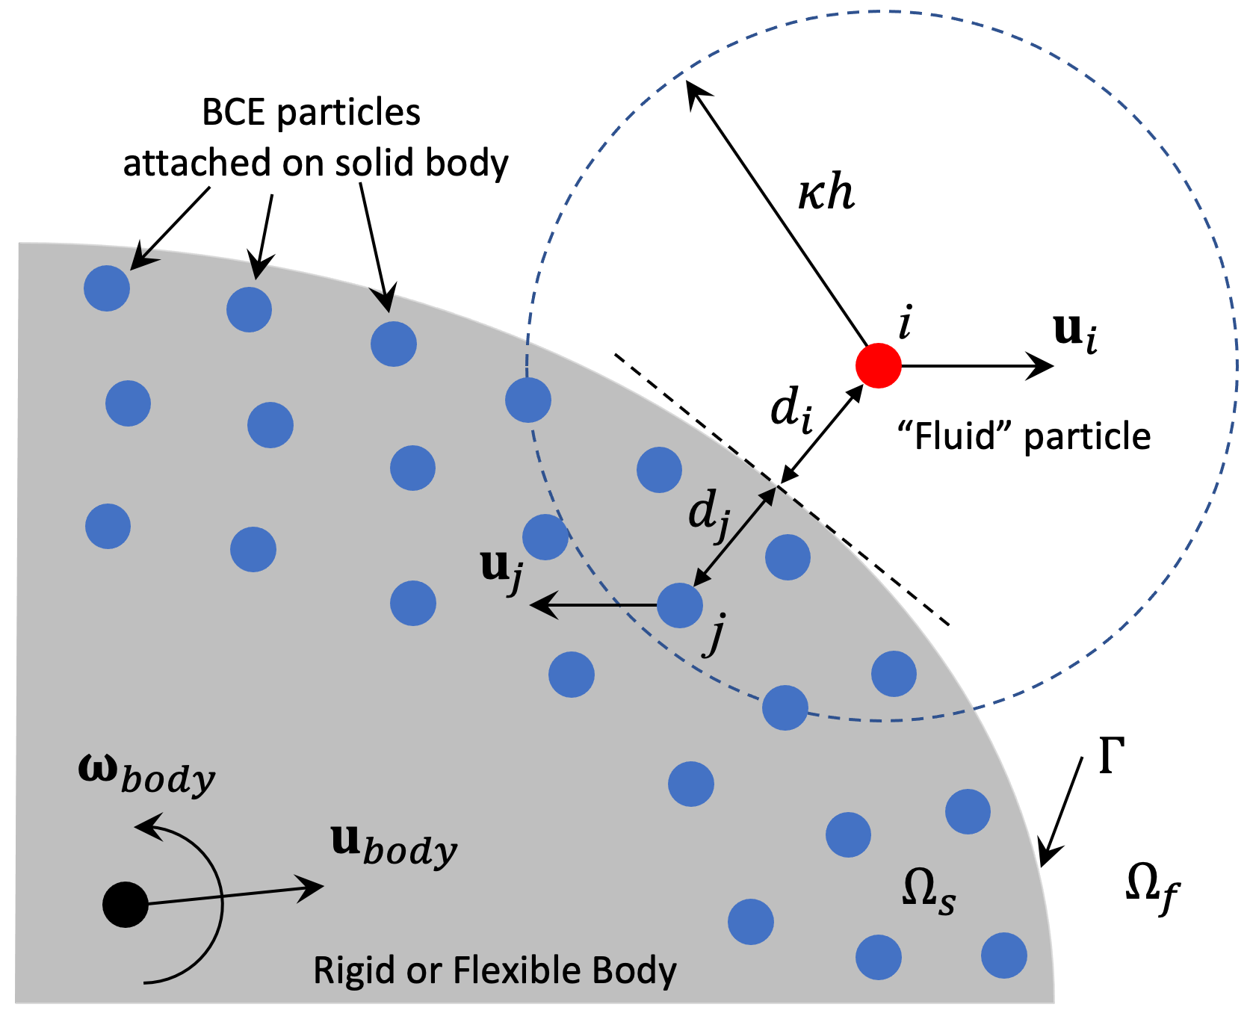
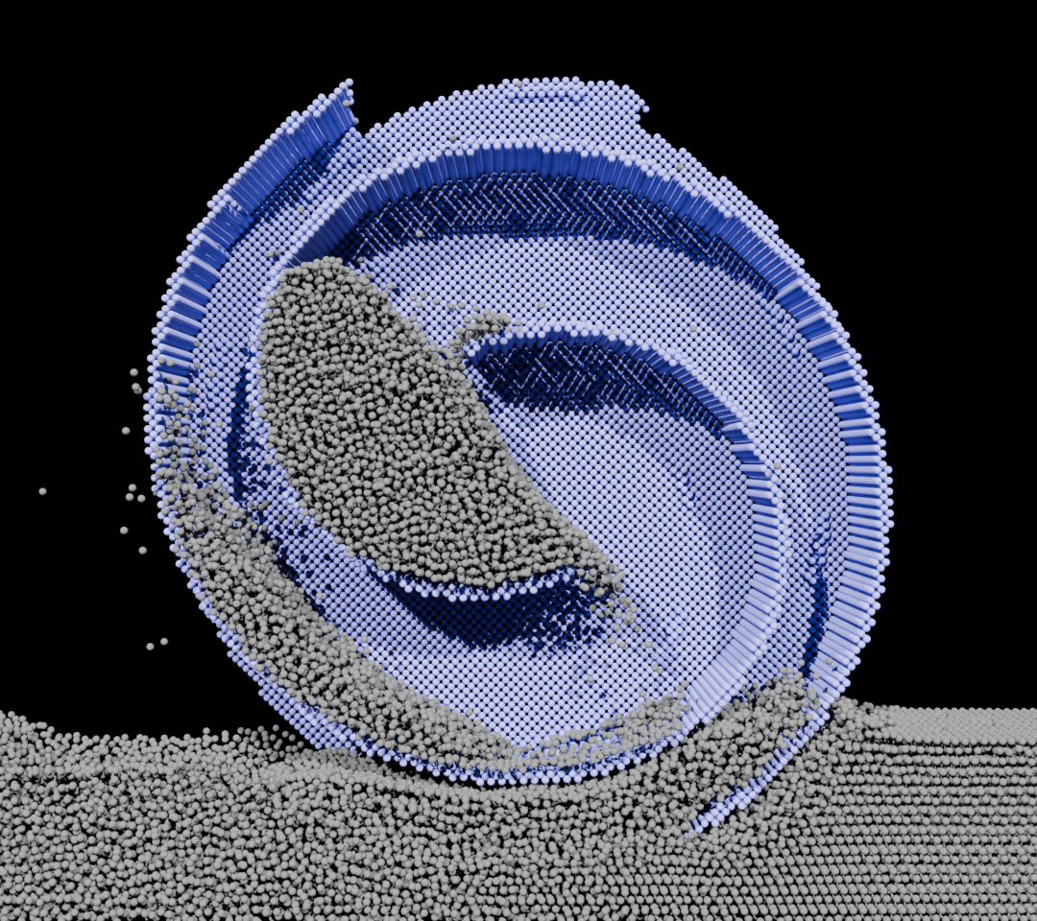
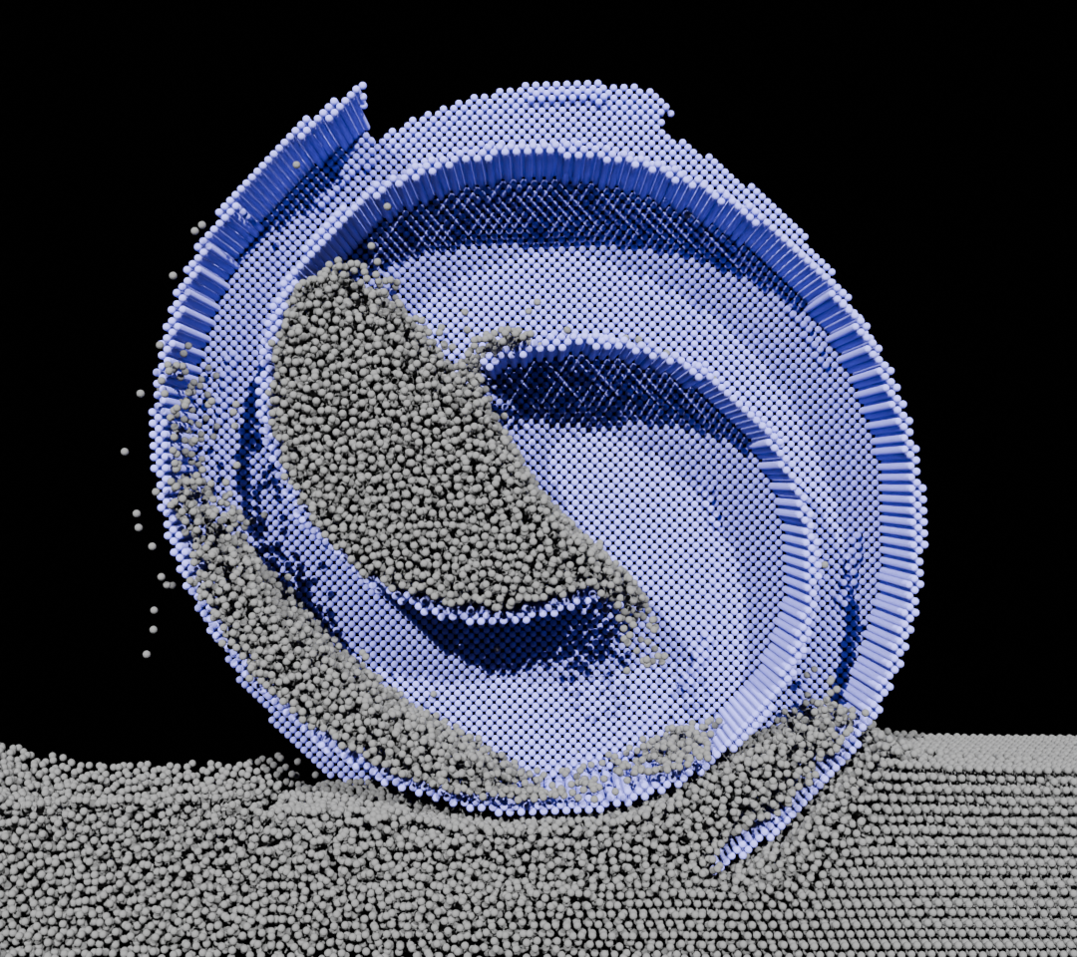
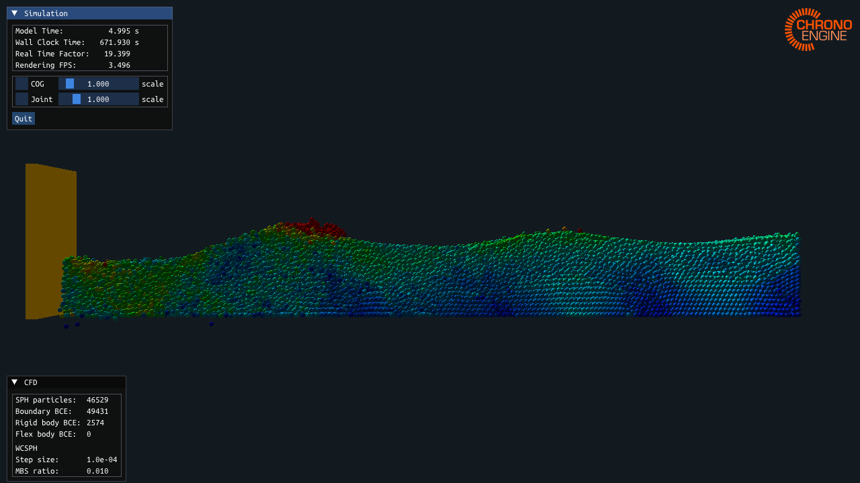
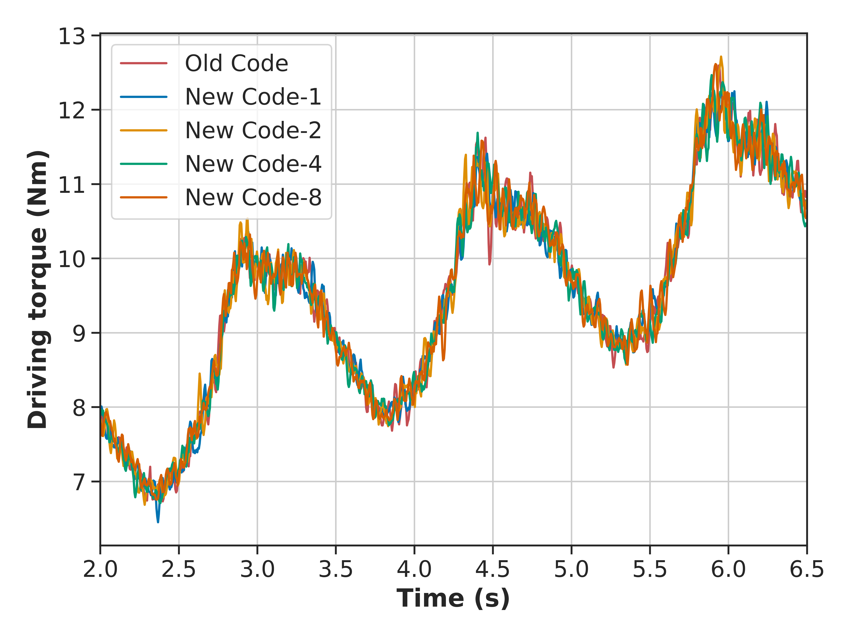
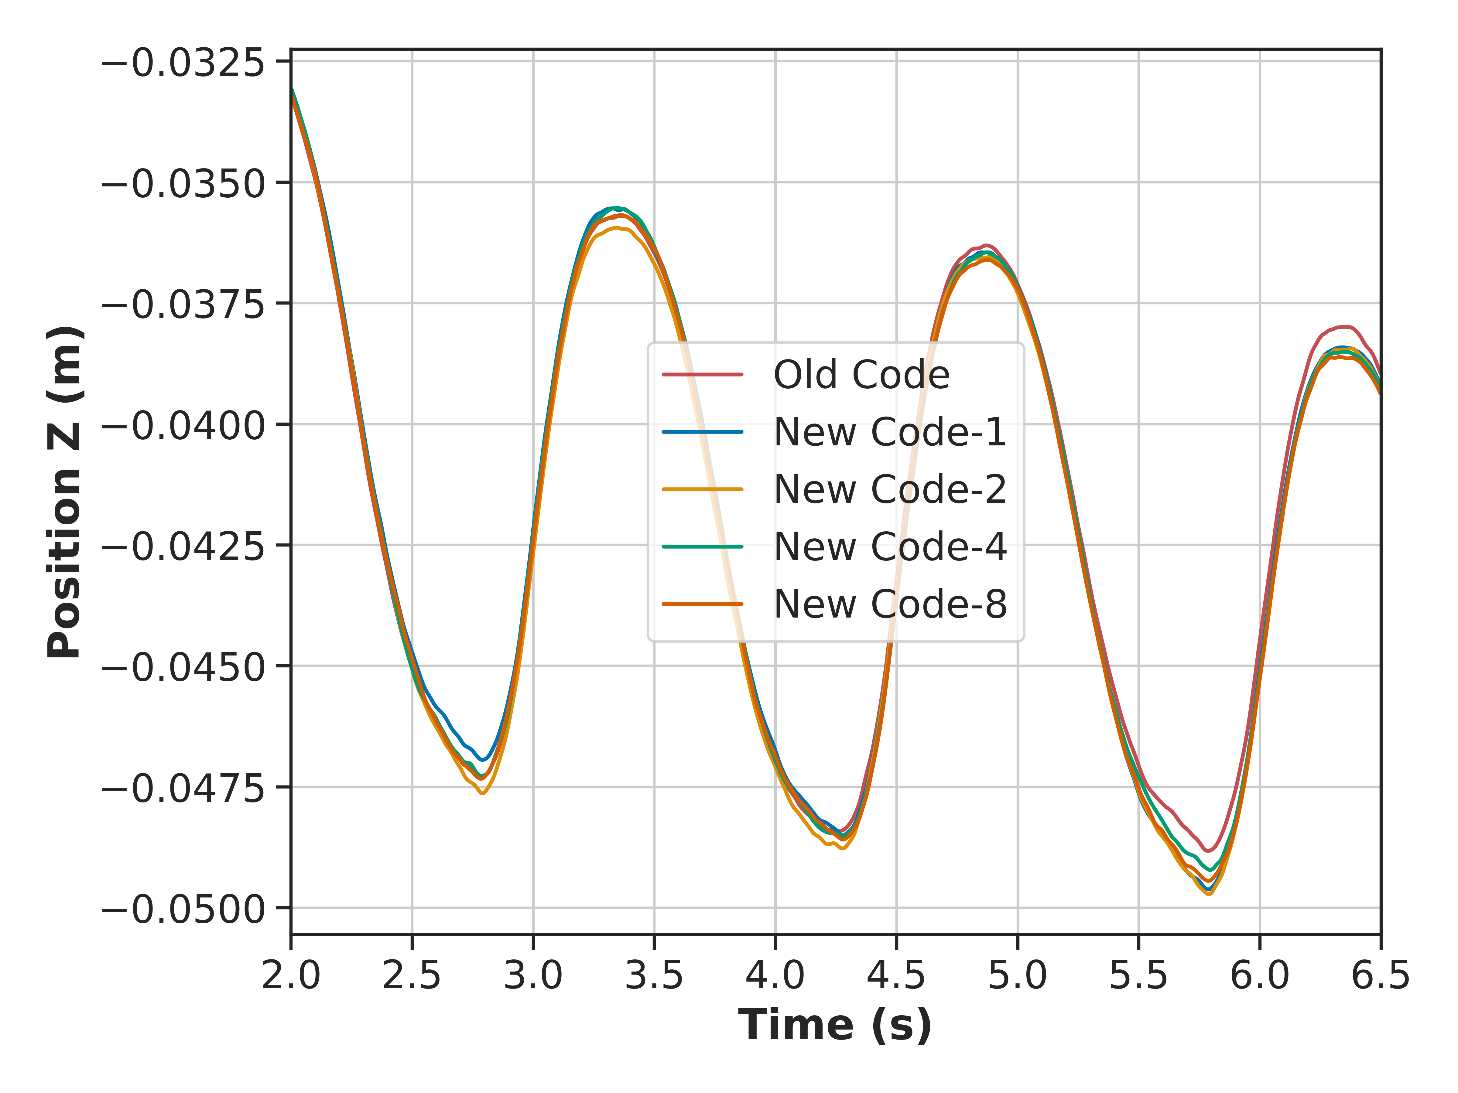
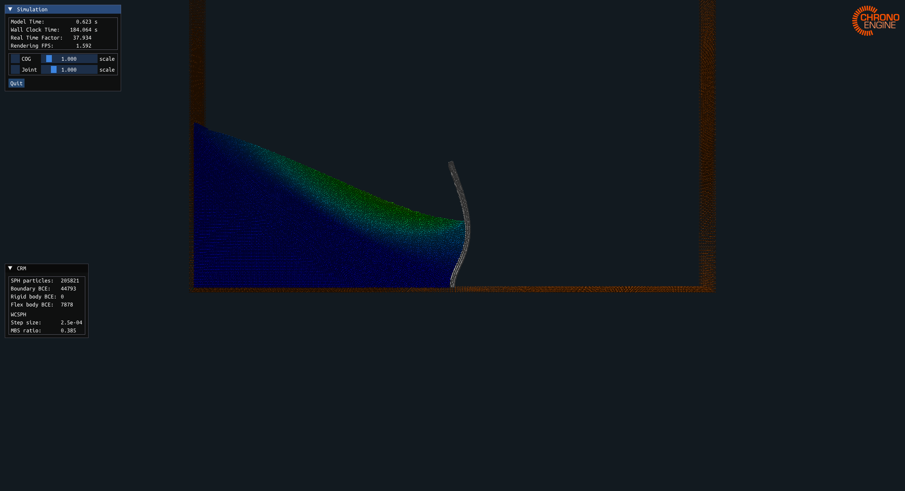
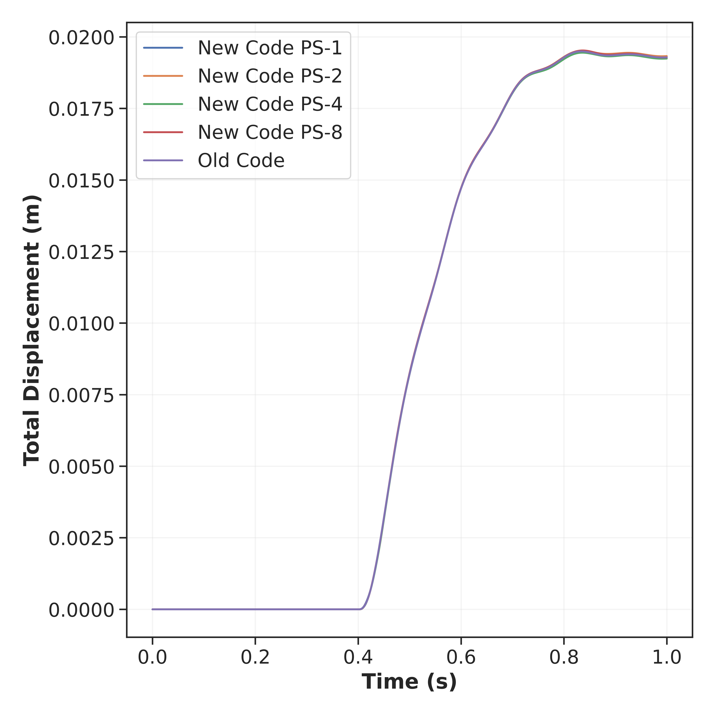
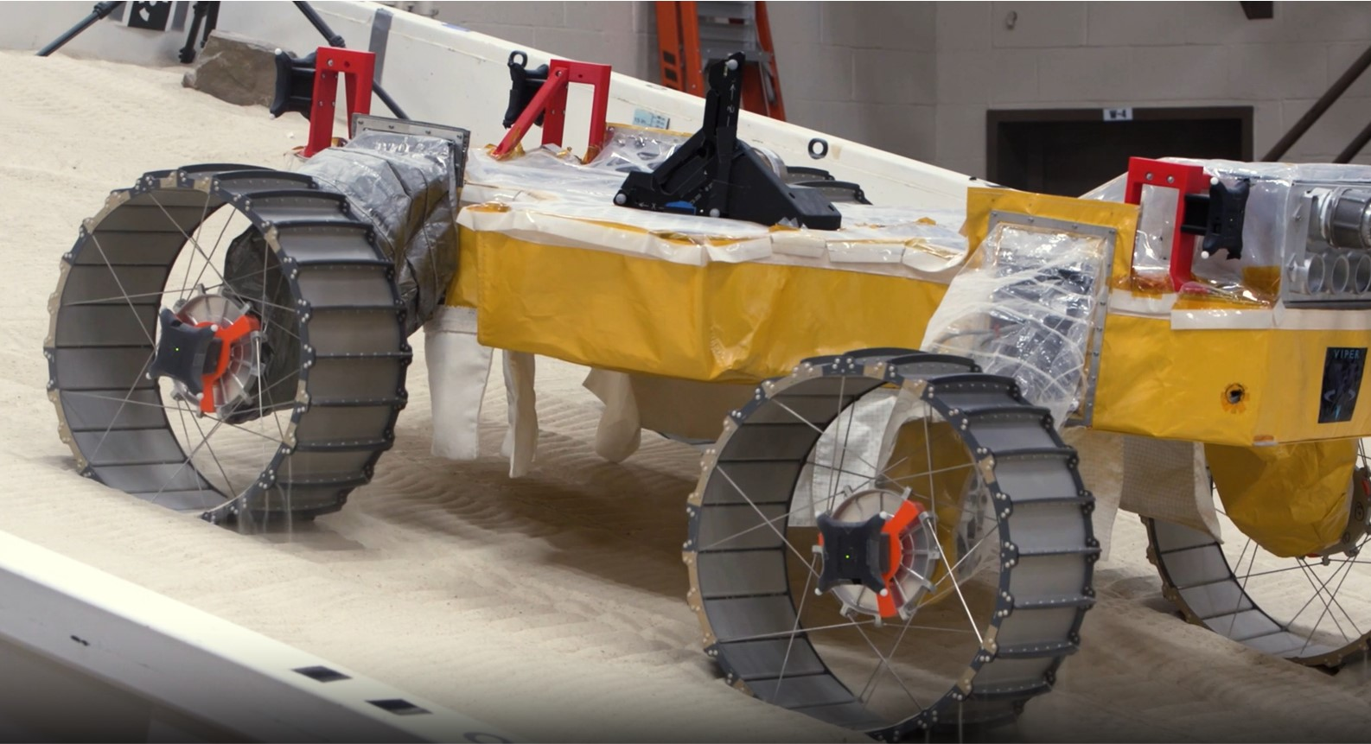

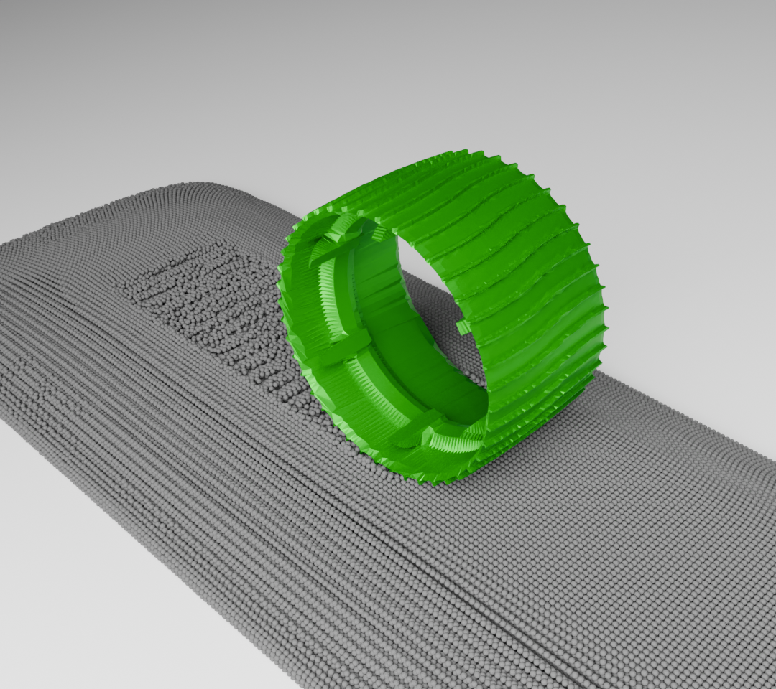

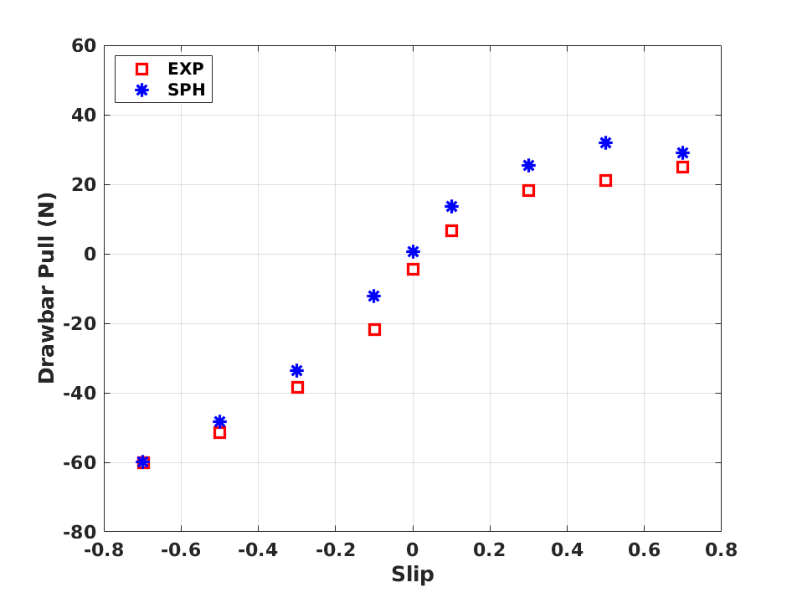
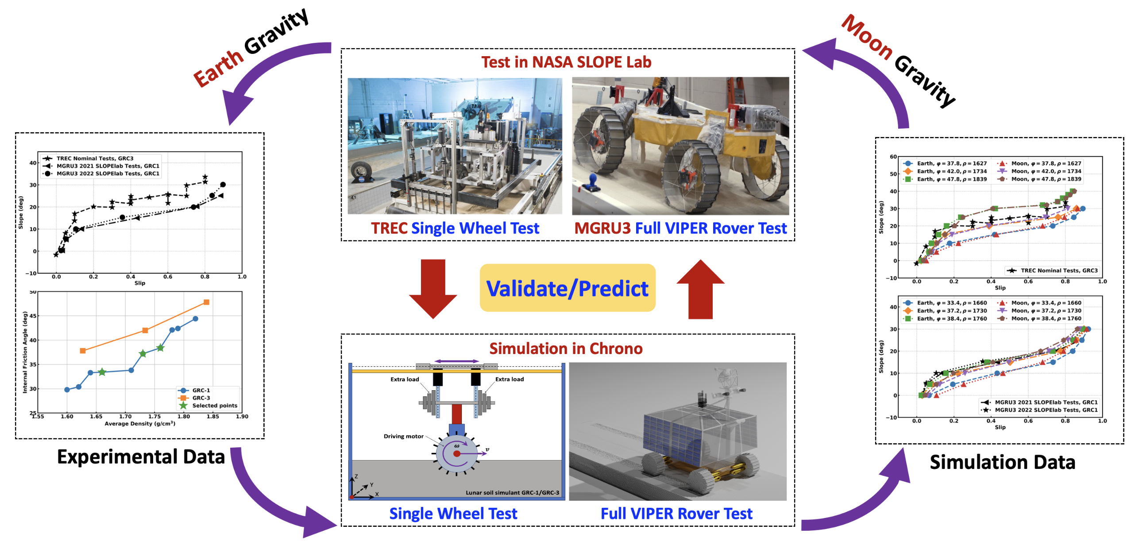
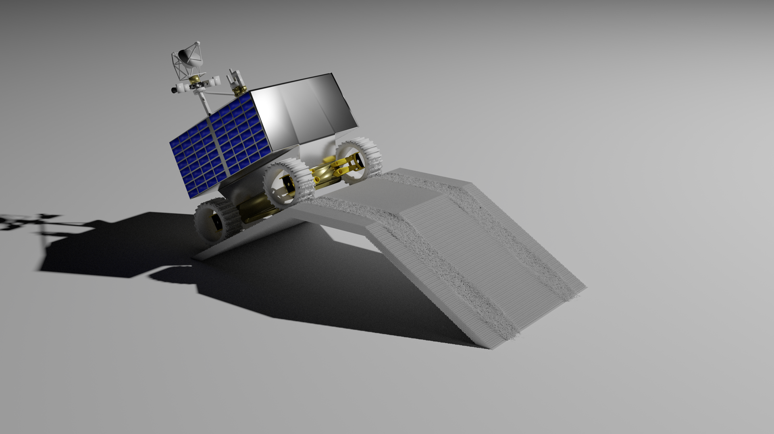
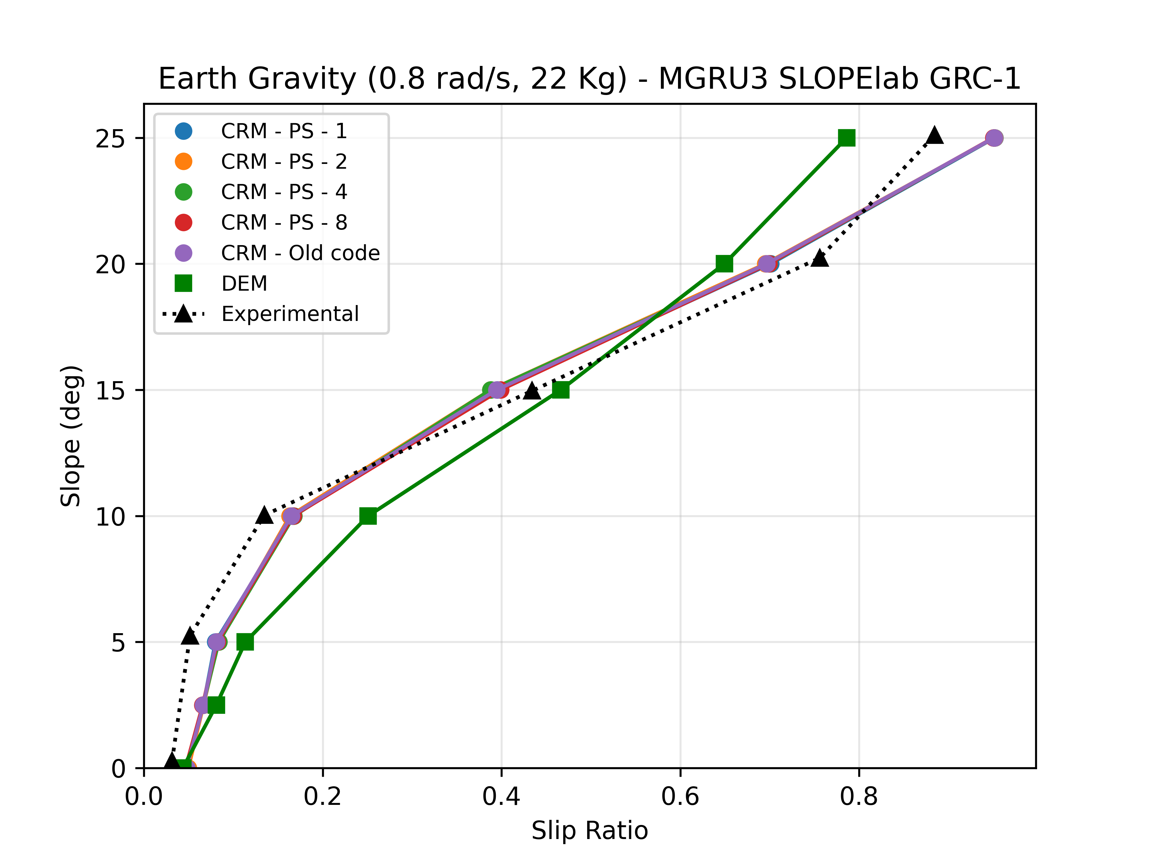
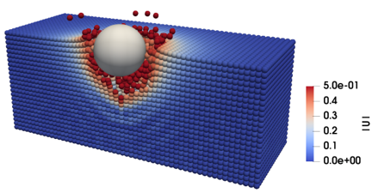
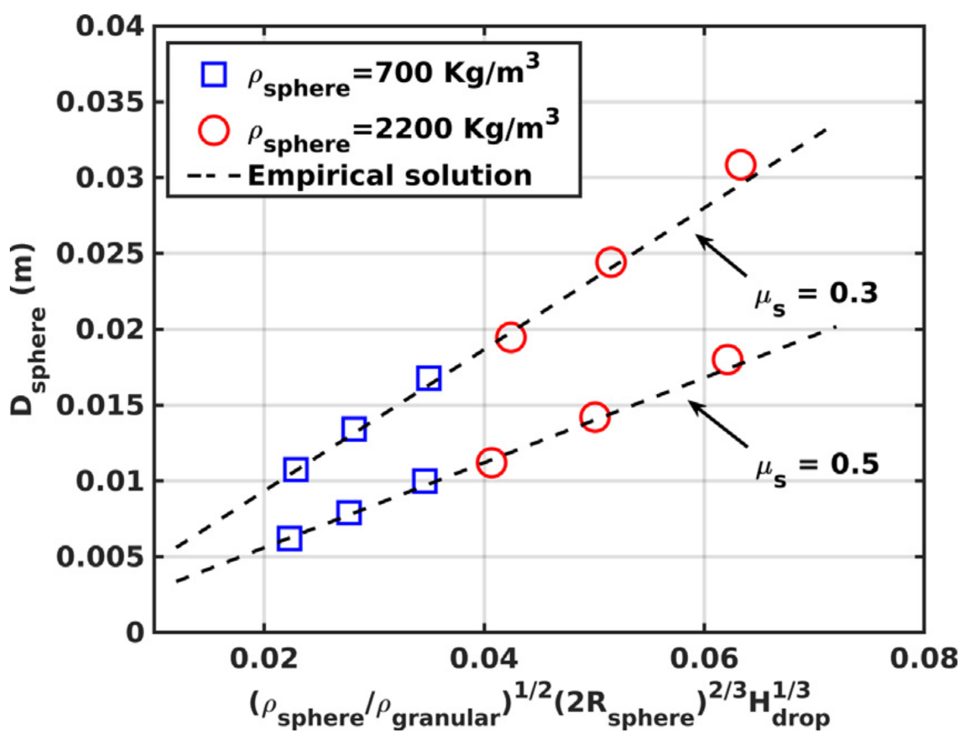
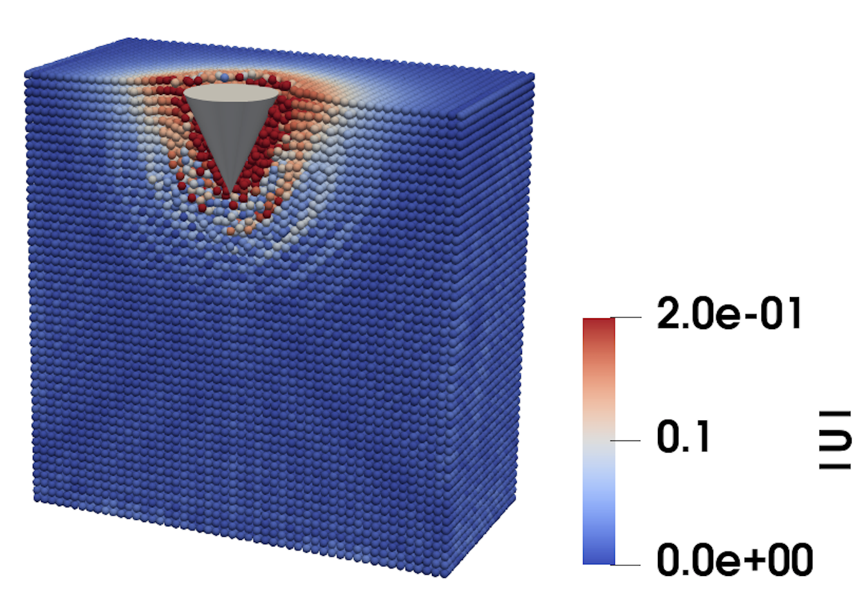
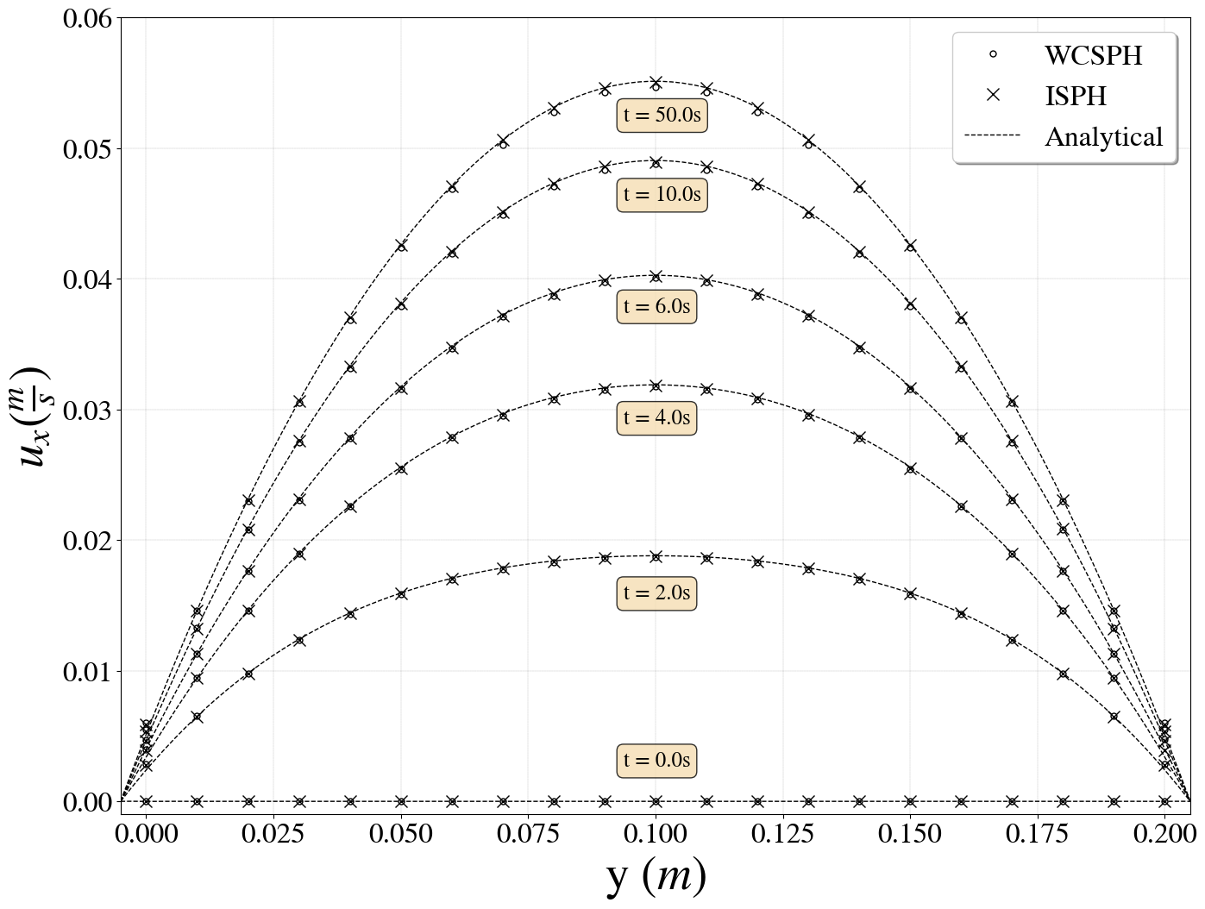
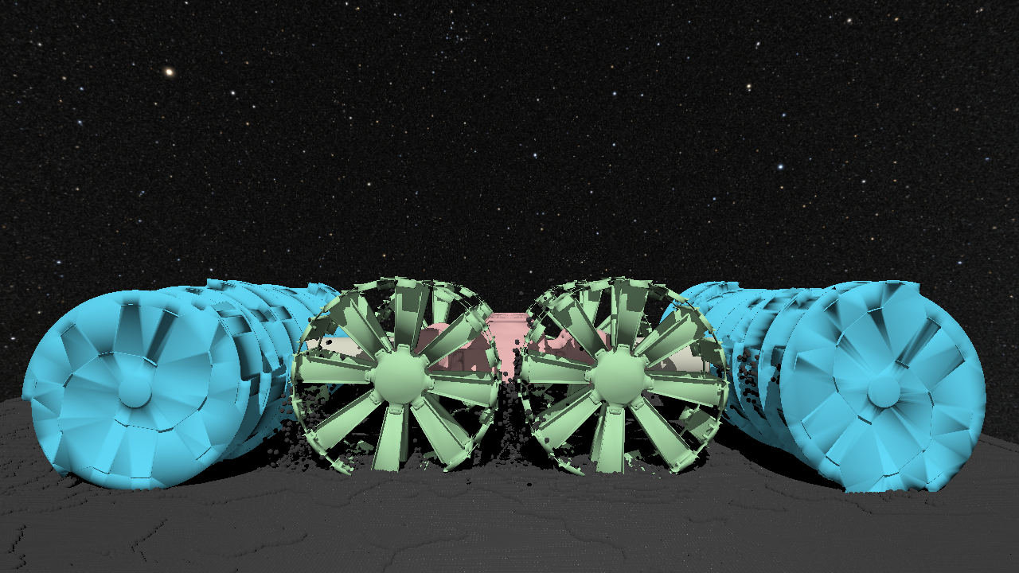
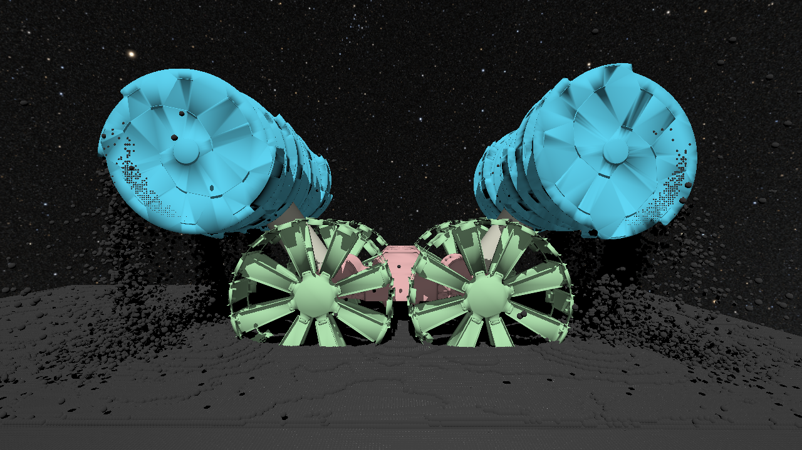
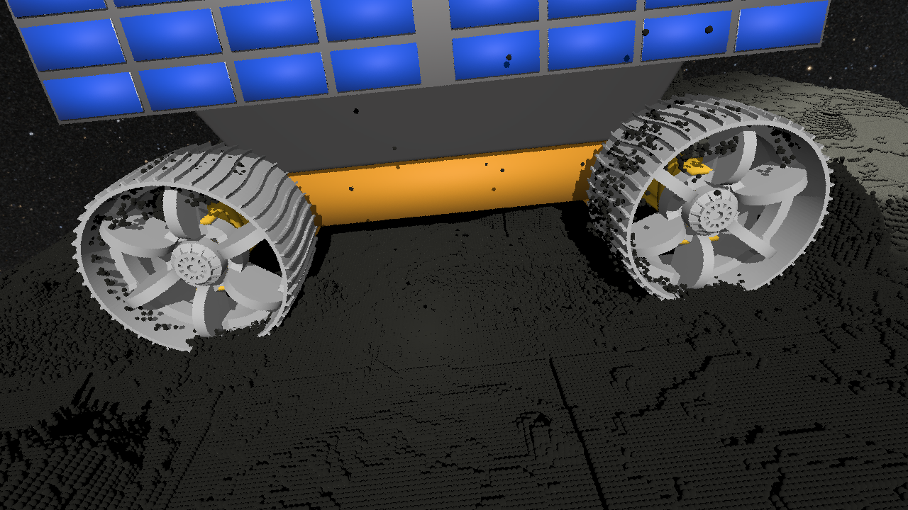
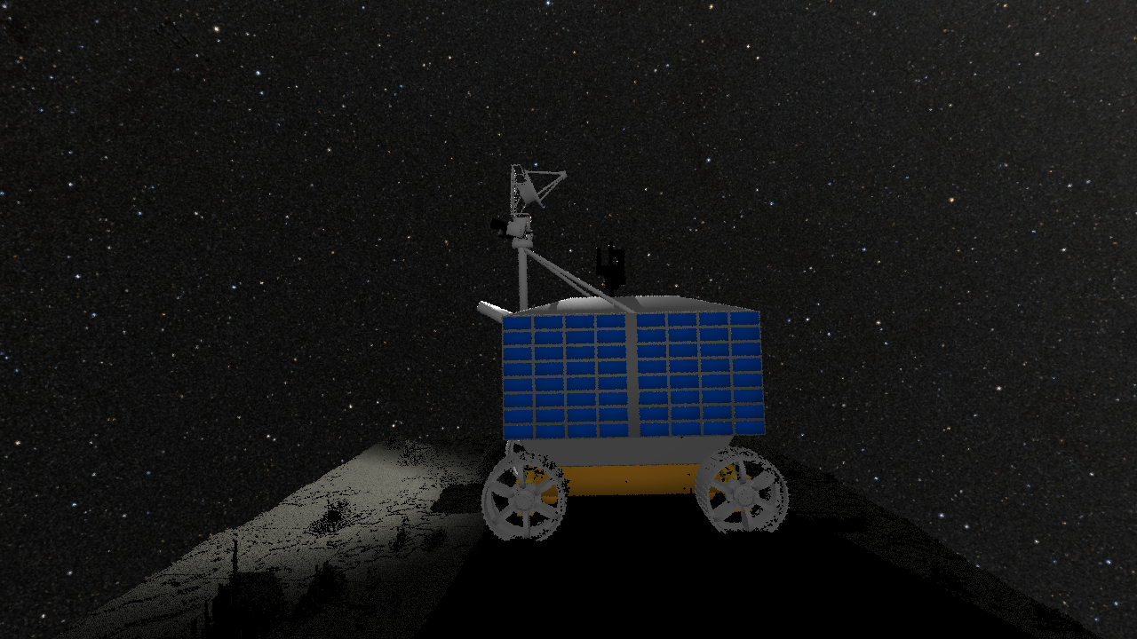
A GPU-Based Fast SPH Solver for Granular Material and Fluid Simulation
unjhawala@wisc.edu
University of Wisconsin-Madison
Huzaifa Unjhawala, Nevindu Batagoda, Luning Bakke, Lijing Yang, Radu Serban and Dan Negrut
2x Faster, Same Accuracy
Chrono::FSI – SPH-Based Multiphysics
2x Faster, Same Accuracy
RASSOR on SPH-based Terrain
Smoothed Particle Hydrodynamics (SPH) discretizes the mass balance and momentum conservation equations
SPH approximates a function based on a spatial average of adjacent sampling points – Proximity Search
Fluid-Structure interaction enabled through Boundary Condition Enforcing (BCE) markers.
Solver can be used for 2 kinds of physics
Fluid – Navier Stokes
Granular Material – Using rheology presented in [1]
Piston based Wave Maker
Old Code
Old Code
New Code
New Code
The Math – Granular Material Edition
Flexible Plate against a Dam Break
Old Code
MGRU Rover Slip-Slope Test
New Code
Cauchy Stress
Rotation Rate
Drucker-Prager Friction Coefficient
Jaumann derivative
Plastic Strain Rate
Plastic Regime
Material Constants
Elastic Strain Rate
Elastic Regime
[1]
Old Code
New Code
Both Granular and Fluid Simulations are well validated
Viper drawbar pull tests match experimental data
Granular Scaling Laws satisfied in simulator ^{[2]}
You can “see” the SPH Terrain with Chrono::Sensor too!
These are images captured using the Chrono camera sensor.
User can control exposure, aperture, type of lens, lens flare, lens vignetting, capture motion blur, account for light transport on the moon, inject sensor noise, etc.
Against empirical results with simple tests^{[3]}
Cone penetration matches experimental data in [4]
Poiseuille Flow
Sphere drop
We optimized the proximity search and made the code 2x faster!
[1] Dunatunga, S and Kamrin, K. "Continuum modelling and simulation of granular flows through their many phases." Journal of Fluid Mechanics 779 (2015): 483-513.
[2] Hu, Wei, Pei Li, Arno Rogg, Alexander Schepelmann, Colin Creager, Samuel Chandler, Ken Kamrin, and Dan Negrut. "Using physics-based simulation towards eliminating empiricism in extraterrestrial terramechanics applications." arXiv preprint arXiv:2405.11001 (2024).
[3] Hu, Wei, Milad Rakhsha, Lijing Yang, Ken Kamrin, and Dan Negrut. “Modeling Granular Material Dynamics and Its Two-Way Coupling with Moving Solid Bodies Using a Continuum Representation and the SPH Method.” Computer Methods in Applied Mechanics and Engineering 385 (2021): 114022. https://doi.org/10.1016/j.cma.2021.114022.
Acknowledgements: This work was carried out in part with support from US Army project US ARO W911NF1910431 and National Science Foundation projects CISE1835674, and OAC2209791.

